Slide 1


Progetto Erasmus plus «Migrants and refugees: the past, the present, the future»
Results of the survey about
migrants’ job and education
ITES Vitale Giordano, Bitonto – ITALY (4- 8 aprile 2022)

Slide 2
This survey
has no statistical
value, but it gives us significant food for thought.
70 people of various
ages participated,
from 16 to 69
years old.

Slide 3
What country were you born in?
The respondents came from 18 different countries.
Although not a statistical sample, it is certainly representative of the schools in the project.
The survey in the Finnish school involved people of 11 different nationalities.
In Greece, 3 foreign nationalities were represented and in Denmark 4.
In Italy, all the participants in the survey, although of foreign origin, were born in Italy.

Slide 4
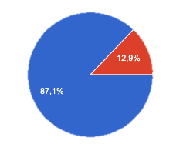
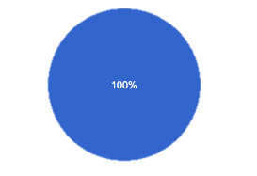
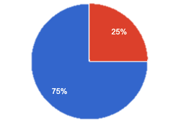
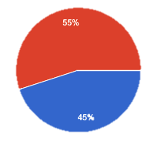
Does your family live in the country
where you live?
YES
NO
ITALY
DENMARK
GREECE
FINLAND

Slide 5


Slide 6
Do you plan to stay in the future in
the country where you live now?
Does your family wish to return to
their country of origin?
Do you feel you belong more to the
country you live in or to your
family’s country of origin?
YES
NO
The country I live in

Slide 7

ITES Vitale Giordano, Bitonto – ITALY (4- 8 aprile 2022)

