Slide 1
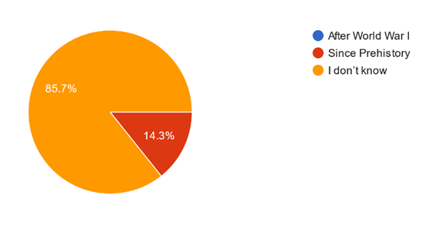
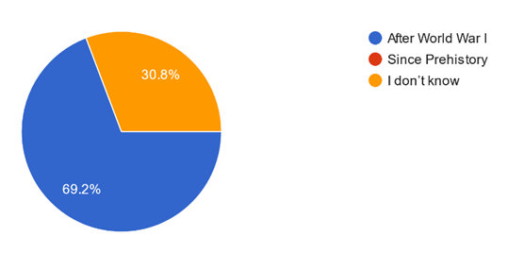
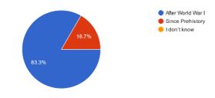
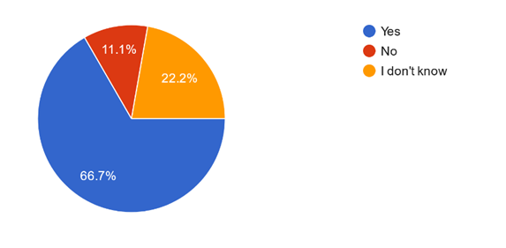
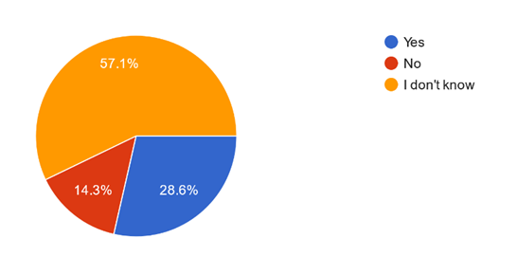
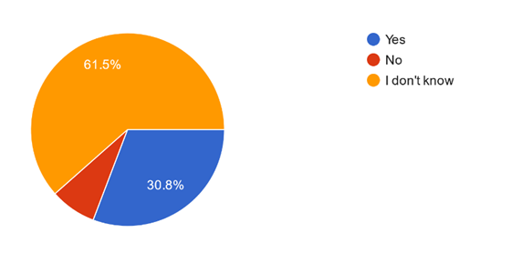
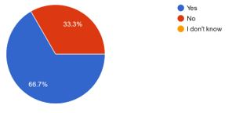
GREECE DENMARK FINLAND ITALY
Q1: The phenomenon of migration has historically appeared:
Q2: Is migration the result of Globalization?

Slide 2
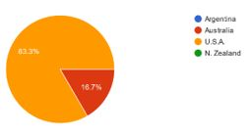
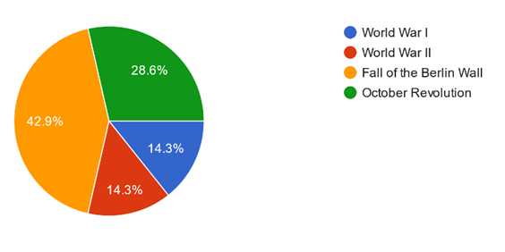
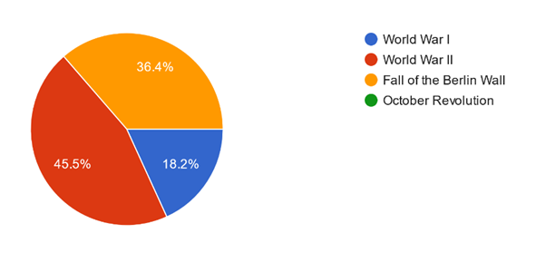
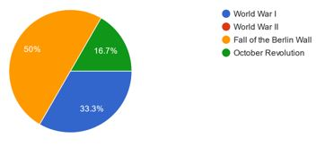
Q3: which country did the Europeans who left their homeland in the late 19th and early 20th centuries mainly had to?
Q4: Europe became basically a recipient of migrants instead of a sender that it was, after the:

Slide 3
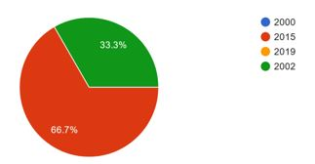
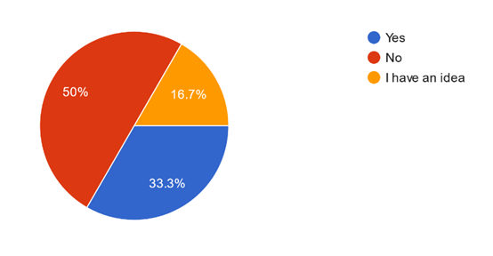
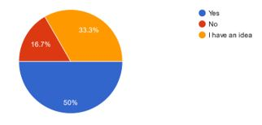
Q5: What was the year with the most refugee flows in Europe in the last decade?
Q6:Do you know what the Schengen Agreement includes?

Slide 4
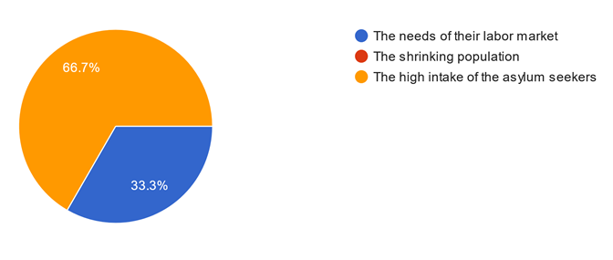
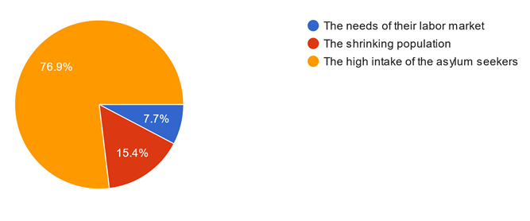
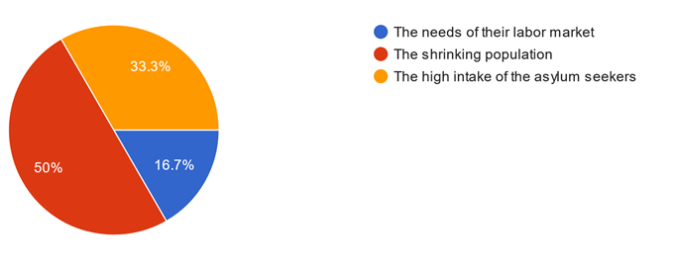
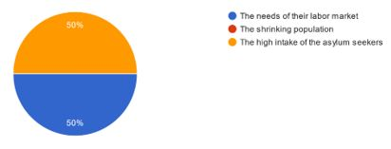
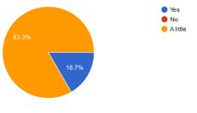
Q7: What made many receiving countries revisit immigration policies?
Q8: Do you know the immigration history of your country?

Slide 5
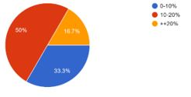
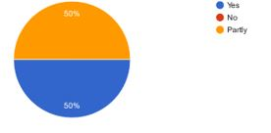
Q9: What is the percentage of immigrants in your country population?
Q10: Do ethnic minorities suffer from discrimination in your country?

Slide 6
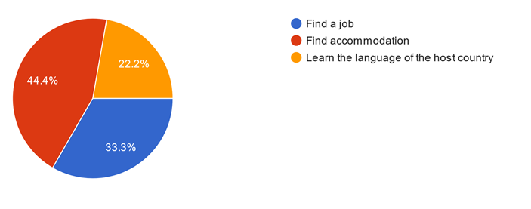
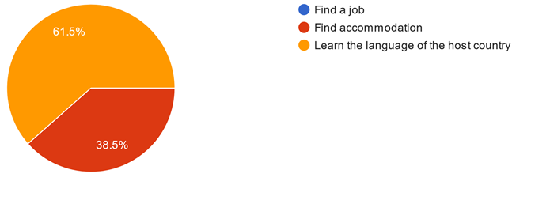
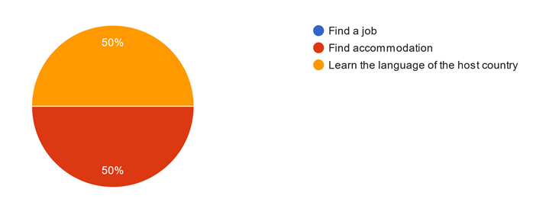
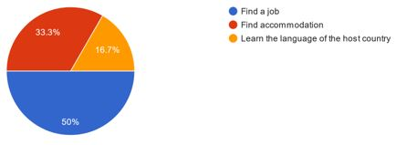
Q11: What is the first thing immigrants do, when they settle in a new country?

Slide 7
Q12:How important is for immigrants to speak the language of the host country and at the same time not to forget their mother tongue?
Language proficiency is extremely important for international migrants. Better language proficiency means easier assimilation in the host country and greater job opportunities and job matches, among other things. Maintaining your first language is critical to your identity and contributes to a positive self-concept. It also helps immigrants to preserve cultural and linguistic connections to their home country.
For me it is important that immigrants learn the language of the host country because in this way they are able to integrate better into society, to find a job without feeling excluded or discriminated. At the same time it is important that they do not forget their mother tongue because it is part of their culture and their life
It's important to learn the language of the host country. It depends on the individual if they need to remember their mother language.
Asuaksesi toisessa maassa sinun on osattava kieli ollaksesi sosiaalinen ja työskenneltävä.
Personally, I think it is necessary especially if you are going to stay permanently in this country. But it is difficult not to forget the motherboard if you do not use it.
It is important because it serves to communicate, establish relationships through a new language without forgetting the native one, to remember that part of oneself not to be forgotten.

