Slide 1
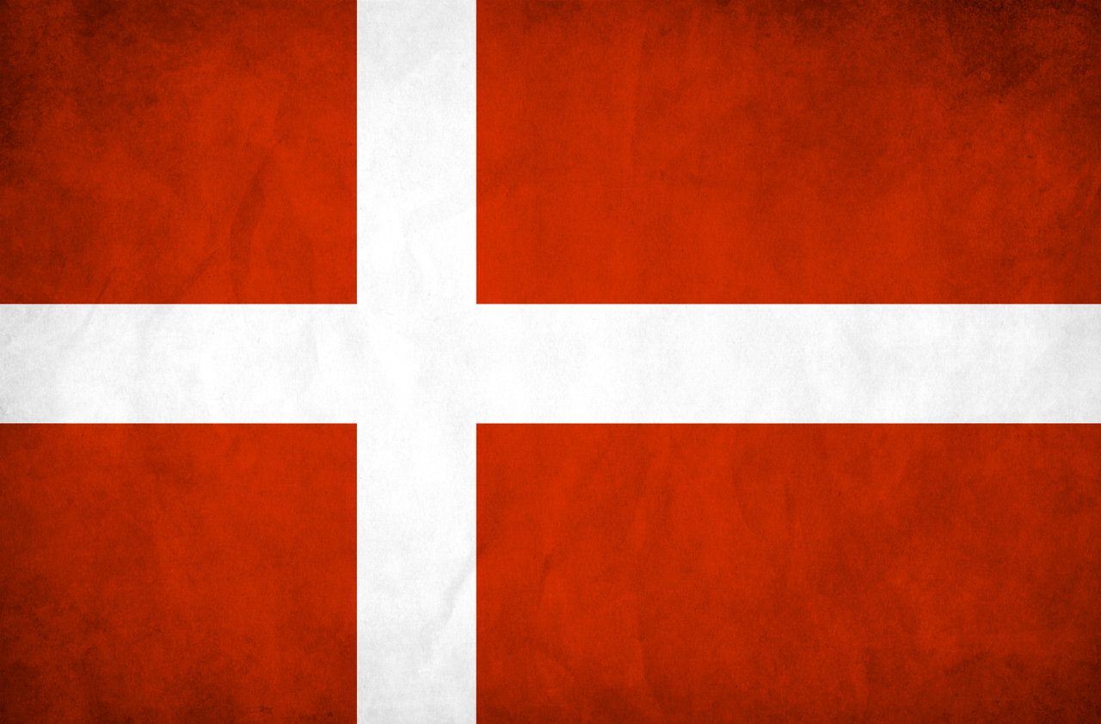
DENMARK

Slide 2
FACTS ABOUT DENMARK
Denmark consists of 1.419 islands, but only 72 are inhabited.
Denmark has over 7.300 km of coastline.
There live about 5,7 million people in Denmark.
Denmark is a democratic country.
We have a monarchy, but it doesn’t decide much
Our queen’s name is Margrethe the 2nd
Danish people have officially been the happiest people in the world… This year we are only 2nd after Finland.
Denmark’s flag is the oldest in the world

Slide 3
CLIMATE
Spring: Weather can change a lot during March and April with lots of rain and sometimes snow.
Usually May is very nice, sunny and temperatures around 18-20 degrees
Summer: June and July are usually nice.. It never gets too hot in Denmark, but we can have up to
30-35 degrees (not very often). It sometimes also rain quite a bit… August can be nice, but
you can feel that summer is fading out.
Autumn: In September leaves start to turn yellow.. It rains a lot, but there can be a few nice days
around 20 degrees. 15 degrees is more likely. October and November are colder and
sometimes we get snow at the end of November.
Winter: You might think that we get a lot of snow in Denmark.. But the fact is that there is more
rain than snow…. Temperatures are usually below 0 or up to 5 degrees… It’s gray and cold.

Slide 4
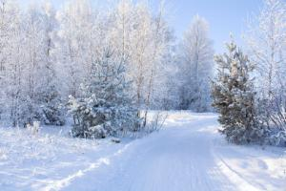
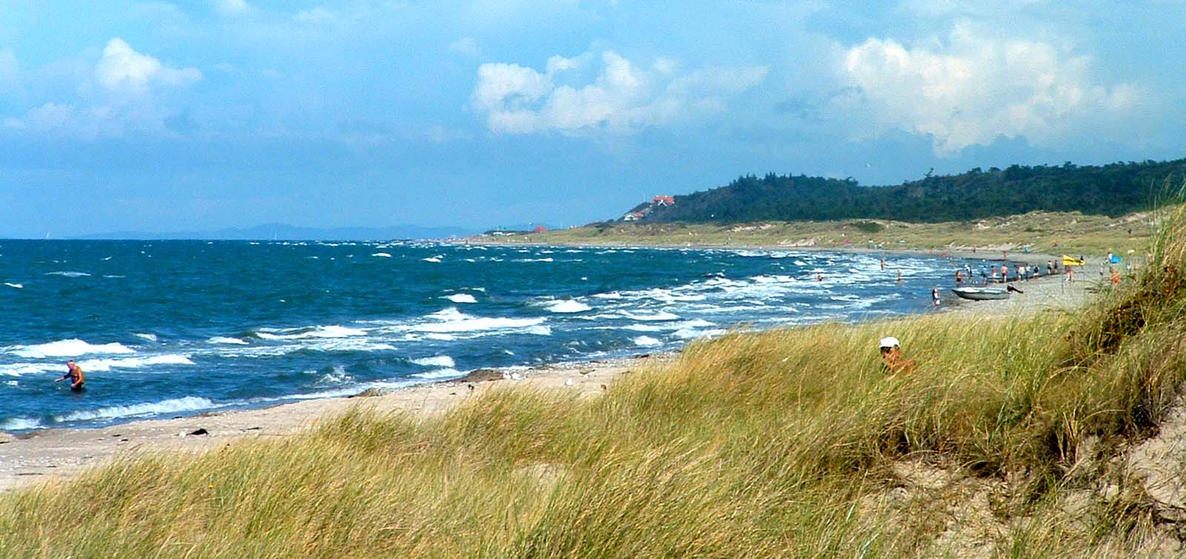
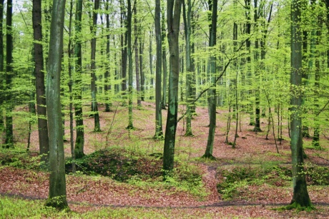
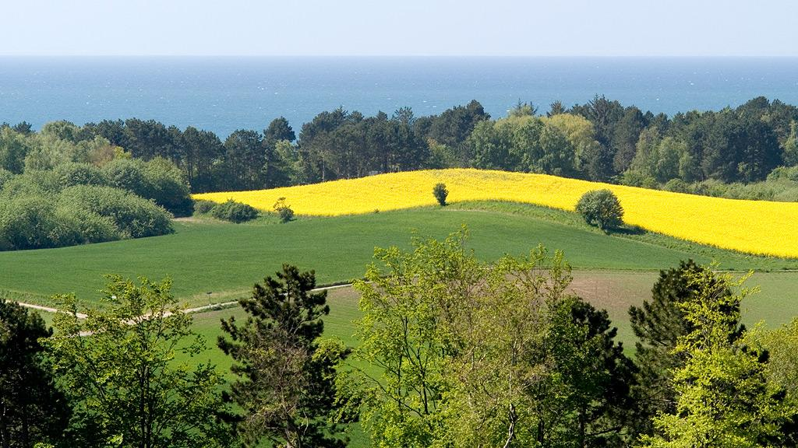
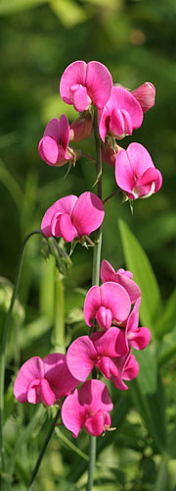
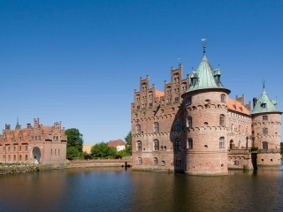
NATURE

Slide 5
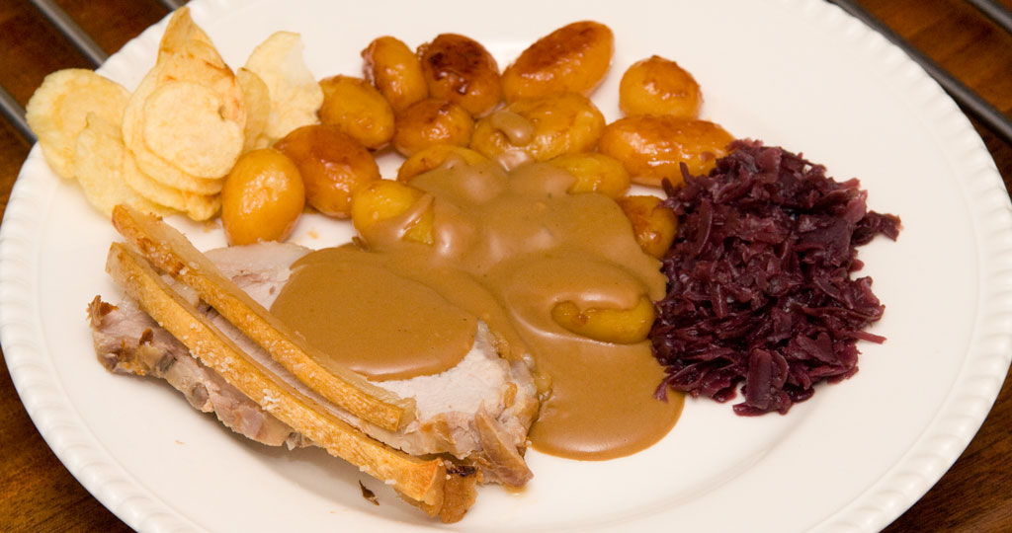
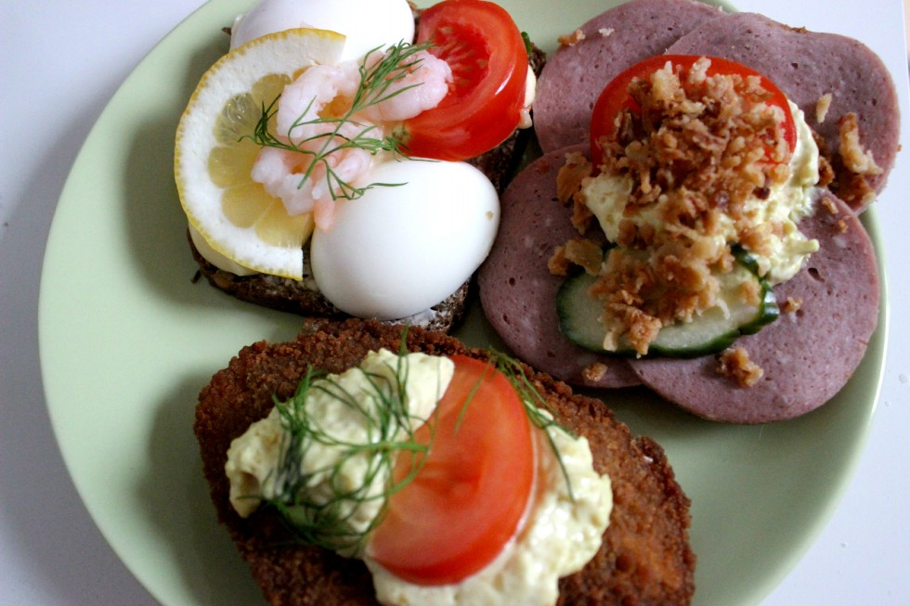
TYPICAL DANISH FOOD
Pork roast with crackling. At the side we eat boiled and sweetened potatoes with gravy and sour red cabbage.
Smørrebrød - Rye bread with different meats and filling. Is eaten for lunch...

Slide 6
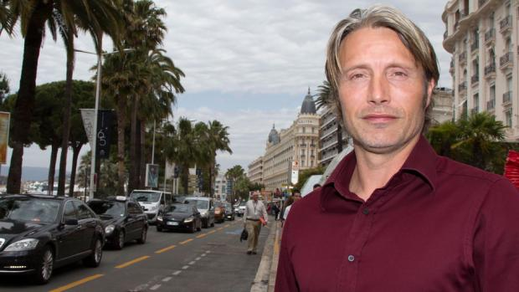
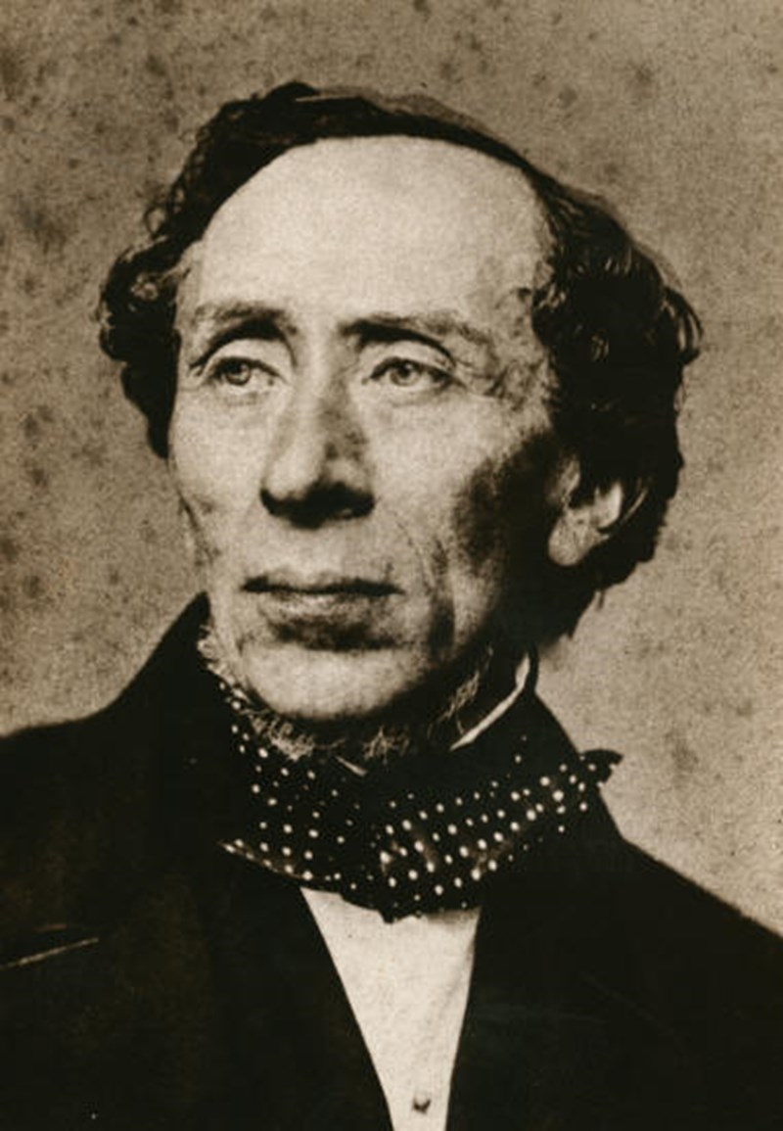
FAMOUS PEOPLE
Mads Mikkelsen - actor
Spanish film: Torremolinos 73
American film: King Arthur (2004)
Casino Royal (2006)
French film: Coco Chanel & Igor Stravinsky
Hans Christian Andersen - poet
World famous for his fairytales

Slide 7
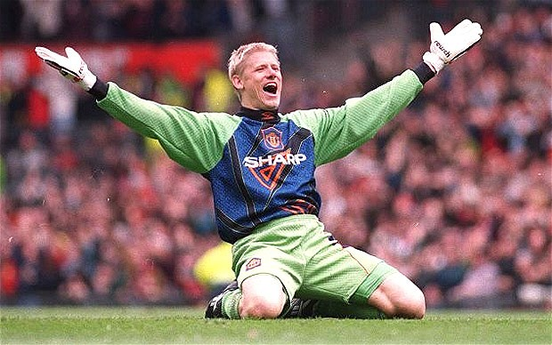
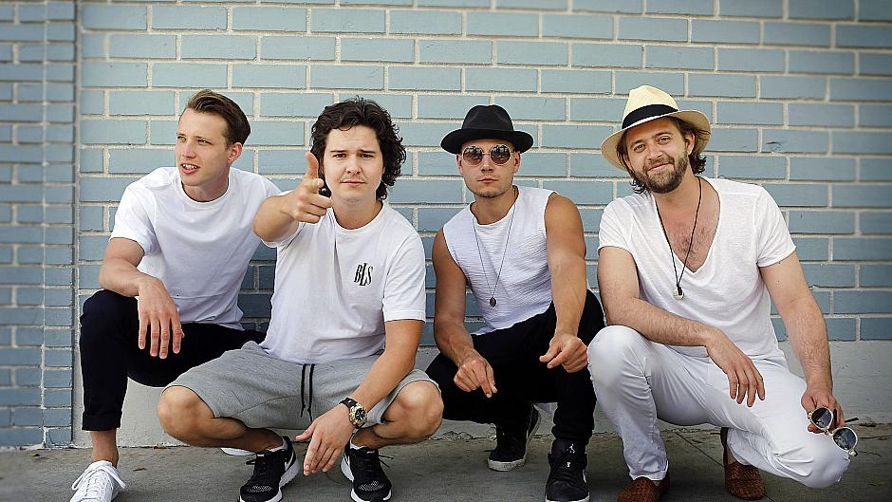
FAMOUS PEOPLE
Peter Schmeichel - Goal keeper
Played 129 matches on the national team.
Best goalie in the world in 1992 and 1993
Played for Manchester United 1991-1999
Lucas Graham
Biggest hits: 7 years or Love someone

Slide 8
THINGS TO DO AND SEE
The Little Mermaid
Tivoli
Legoland
Kronborg - the castle of Hamlet

Slide 9
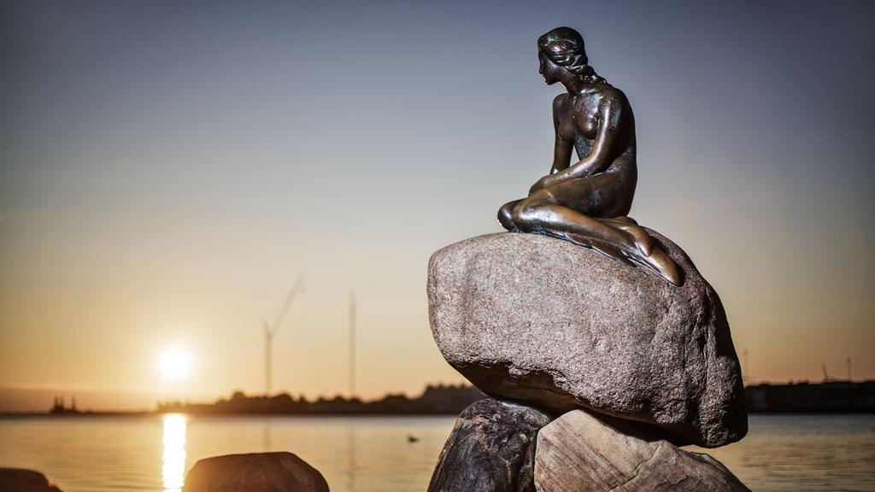
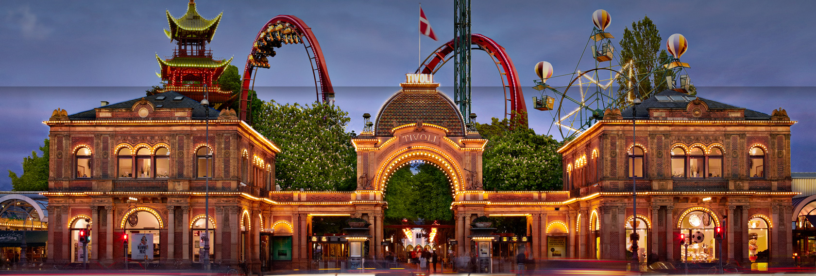
The Little Mermaid and Tivoli
The little mermaid:
The sculpture is located in the harbor of Copenhagen, and
has become a Danish trademark.
-
Tivoli:
Tivoli is also located in
Copenhagen, and is the
oldest amusement park
in the world.

Slide 10
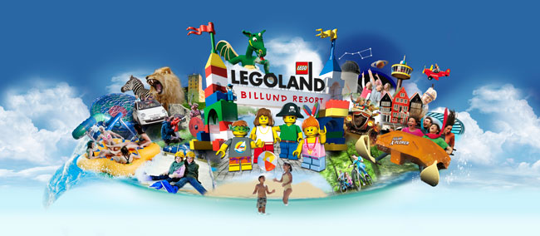
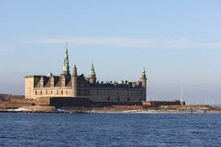
Legoland & Kronborg Castle
Kronborg is the castle known for
Shakespears play: Hamlet
Legoland - A city full of colorful plastic bricks and
funny rides. There is a hotel with theme rooms.

Slide 11
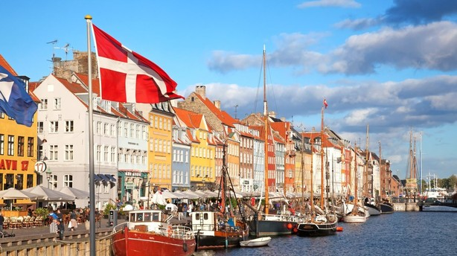
We hope you will enjoy...

