Slide 3
OuR imMIGRANT students STORIES BOOK

Slide 4
Ioyliana A STORY OF AN IMMIGRANT
It all started 17 years ago, when my father left Romania to go to Greece, obviously to work. I was about 2 years old, I was with my mother while my father was working in n another foreign country. He often came to see me and my mother, because it was difficult for him to be alone, until he decided to take me and my mother to Greece for a nice vacation ,until the 2 of them decided to stay in Greece and for me to start school here and my mother to find a job in Greece. At that time, Romania was not in the European Union, that is, in 2006, and obviously my parents did not have all the documents they have now, they worked illegally, because there was no other solution, they were afraid, like everyone else in that situation.

Slide 5
Ioyliana A STORY OF AN IMMIGRANT
In 2008, when Romania joined the European Union, they started preparing their own documents and mine, so they had no reason to worry about anything happening. I started school in 2009, I liked it and I still like it now that I am almost at the end of it.
Obviously, I intend to go to university and continue my life in Greece, I do not know if forever but certainly for a few more years. Although my parents and I are in a foreign country, we go on vacation to Romania at our holiday home and have a great time every year.

Slide 6
Sveta’s story
Sveta Sherdits is a girl from Croatia. She tells us about her experience and about her willingness to help immigrants and refugees who come to Greece.
In the Erasmus program, we learn about immigrants and refugees in our country. Their stories are about how they live and what they have gone through. I, as a person who came from another country alone, while my guardians remained in the war zone, understand what they might have been through. But I was lucky ... I had a grandmother and after 3 years my parents came to Greece, while other people (children) came here without knowing the language and not having anyone to support them. Many of them travelled in terrible conditions, having lost everyone in the war, and when they reached our country, they felt contempt and neglect.

Slide 7
Sveta’s story
These people are very strong, they were able to survive and are gradually adapting here. Greece was one of the few countries who accepted and helped them. And for that I am proud of my country! I came to the Erasmus program to learn more about these people, about the culture of other countries and to support them - help them. Because when I was in their place, I faced bullying, but there were also those who supported me and helped and these were the local people.
And now I want to help them become stronger, forget the past and love this country as their own.

Slide 8
Albi’s mother’S personal story
Mrs Rudina is a migrant from Albania. She told her son Albi her story about coming in Greece 22 years ago and having her family in a foreign country.
“We came in Greece 22 years ago...how fast years pass...We were newly married. It was our first time leaving our own country and our close people. I had heard about Greece and its story but I didn't even know one word. It wasn't easy at all.
When we first came, we were staying at our friend's house and after two months we rented our own flat. I remember having feelings of excitement, anxiety, stress and other weird feelings at that time. I had to build my life in a foreign country, I did not have another choice. As soon as we got in our house, neighbors came to meet us and help us as much as possible....it surprised me because I had heard other things about Greece.

Slide 9
Albi’s mother’S personal story
I started to feel that we weren't alone and we were encircled from goodhearted people.
At the beginning, my husband found his first job, for me it was more difficult...Life kept going with its problems but the most important thing is that we were legal. I gave birth to my children, I was busy raising them and helping them with the education and with that chance I studied Greek too. During the first years at school, they experienced racism and bullying but as the time went by, they made friends and racism stopped. Friendship got stronger between them. Racism is a problem for parents as well because they see their children experiencing racism but fortunately, we got over it easily.
Nowadays, everything is on a straight line and we feel safer here. We don't feel this country as a foreign one. We have made friendships and our jobs are secure. My kids now have a Greek passport and they are studying in Greek schools without any problems”.

Slide 10
Masoud’s story
Masoud is a non adult refugee from Afghanistan.
He is a student in our school. He has lost his parents so he is all alone in Greece. He speaks English and he knows some Greek words. When you speak to him in Greek, slowly and clearly, he can understand a little and this makes him so happy.
“During the pandemic, I missed the appointment I had for an interview to take my passport. Now I will have to wait for at least two months.
I lost my sport activity in football because I was a member of a football team.
I am worried about my health because of Covid-19.
I am a refugee here in Greece and I live with twenty other adolescents in an apartment, so I have to wear my mask all the time. So, it is very difficult for everyone.”

Slide 11
an interview from falak
Miriam is a fifteen years old girl who studies at the Galatsi Second EPAL. She has been born in Athens, Greece but her parents are migrants from Nigeria. They have been living and working in Athens for 20 years. Miriam speaks Greek, English and Nigerian.
Falak is in the same class with Miriam. He is a refugee from Pakistan and he doesn’t speak Greek at all. He speaks English fluently so his classmates and the teachers try to translate their words in English.
Miriam took an interview from Falak in order to get to know him better.
Miriam: How long have you been leaving in Greece?
Falak: Ι have been living in Greece for two years.

Slide 12
an interview from falak
Miriam: Were things hard for you?
Falak: Well, the beginning was very hard because I was new here, I was alone, I mean I don't have any family members here, I didn't know anyone, I didn't have a place to stay in, I was illegal, I didn't have any paper, a lot more problems. So, all these things made it very hard.
Miriam: Do you have any family like friends, brothers or sisters here in Greece?
Falak: No, when I came here, I didn't know a single person. Also, I don't have any family or relatives in Greece, not even in any European country. I am all alone here.

Slide 13
an interview from falak
Miriam: How do you see Greece as a country?
Falak: Well, I would like to explain the answer more than just saying it's good or bad. So, in my opinion, I believe Greece is a good country. Although here in Greece we have economic crisis, it's hard to find a job here, the salaries are very low here, etc. However, life in Greece is very easy (chill) and affordable. Compare to other European countries Greece and Greeks are good (for example, we all know what is happening in France with the Muslim community) so compare to other countries here in Greece people are nice and friendly. (personal opinion).

Slide 14
an interview from falak
Miriam: Do you like the school here? Are children friendly?
Falak: For this question, I also would like to share my experience rather than just saying yes, I like it or I don't. So, the first day I entered the school (with due respect) but I felt like I came into a juggle and I felt that way because I was just coming from an international American school from a different environment. Where everything was perfect. There everything was so different compared to this school. Here when I entered the school, I saw pupils were smoking inside the school, loud music was playing, etc. However, now I am getting used to the school and its environment. I am still not comfortable here because of the language and new or different people but I feel like I am liking it too, because of some reasons such as the effort of teachers who really want us to participate in the class, and not just watch but also trying and working for it. Which we all can see, for example, speaking for us in English which they don't have to do but they are doing that extra for us. I really love the idea of working together in a group or as a team. Which will allow us to get involved with each other and become friends, so we won't feel lonely.

Slide 15
an interview from falak
Miriam: How do you feel and think about this virus?
Falak: Well, it's a global problem, and the whole is affected by this virus, everyone is suffering from this pandemic, so am I. Also, for us, it's a bit different from everyone else. For example, other people can go out for so many reasons such as: going to the supermarket, going for a walk, exercise, job, etc. But we cannot go out at all. In the first vibe of this virus, we were locked in the house for more than 3 months. Which caused us so much of mental and physical problems.
Miriam: Do you think exercising or doing a sport is important to you or for our health?
Falak: Indeed, it's very important for our health, as I mentioned in the question above that going out for a walk, exercise or playing a sport is very important for our mental and physical health.
Miriam: Thank you Falak for sharing your thoughts with us.

Slide 16
zbeda – my story
My name is Zbeda Hamed, I am 21 years old and I come from Egypt. My father arrived in Greece 30 years ago as a financial immigrant and shortly after he brought my mother and they raised our family here.
In Greece I feel comfortable and safe. I really like painting.

Slide 17
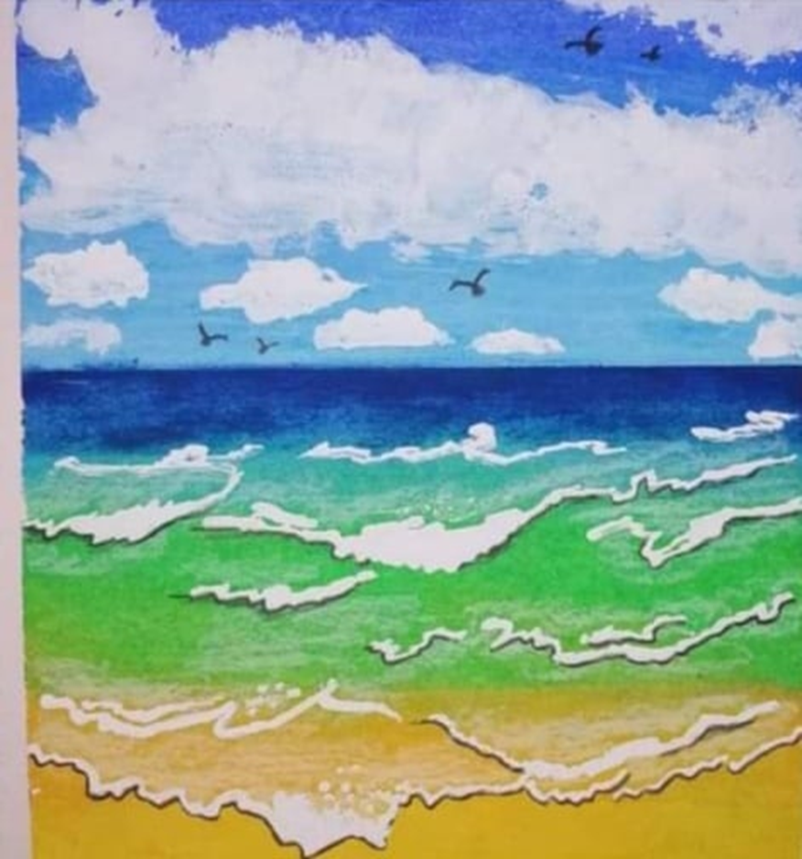
zbeda – my story
"Calm and comfort“

Slide 18
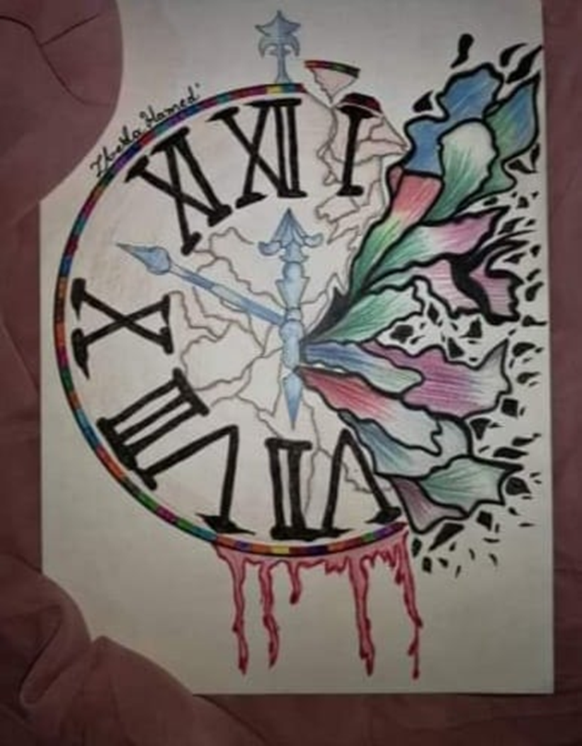
zbeda – my story
"We can invest time in useful things"

Slide 19
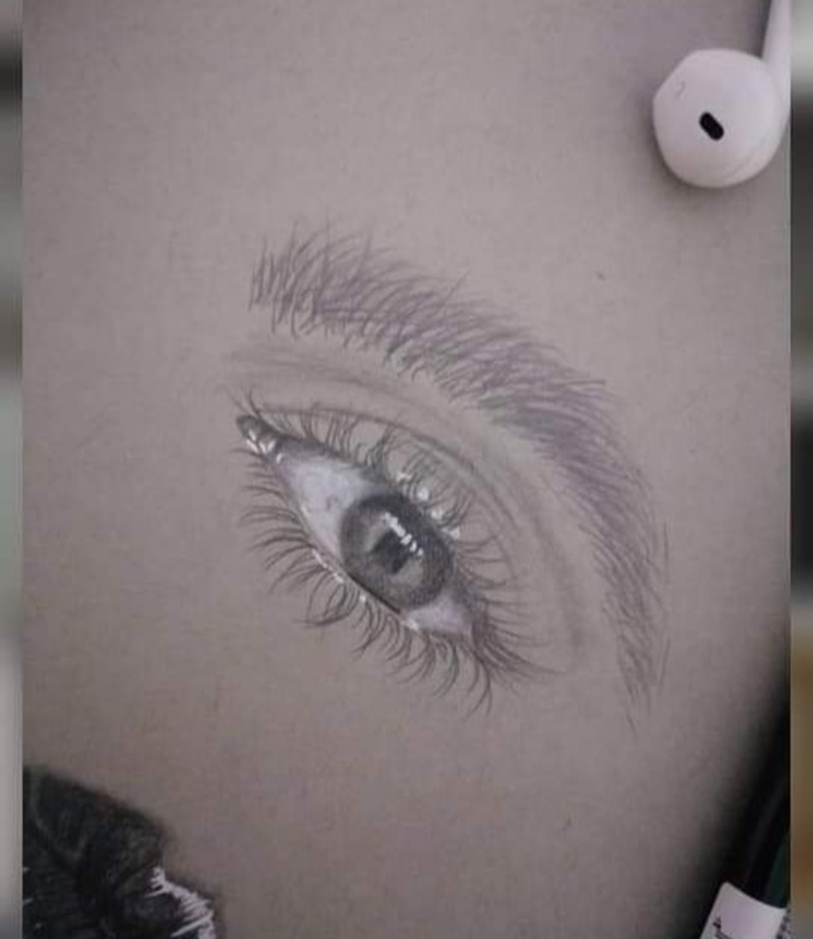
zbeda – my story

Slide 20
Amiri - my story
What is a refugee? A person who leaves his/her country because of war or persecution and enters another country seeking for shelter, according to the international law, is an immigrant-refugee.
My name is Amiri Rahmat. I am 18 years old. I arrived in Greece three years ago and now I live in Switzerland.
I come from Afghanistan. My family is big. I have 4 brothers and 3 sisters. The violence towards my family and my kidnapping led me to leave my country.
I left my country because of the violence, the persecutions and the war. Most importantly, I couldn’t continue my studies there. The insecurity I felt from my early years forced me to want to study, so I left my country.

Slide 21
Amiri - my story
This immigration, via camels, horses, cars, lorries and other means of transport kept on for several months. There were families that died because of famine and thirst.
I faced a lot of difficulties and I was even separated from my family.
There were a lot of difficulties during my immigration but they were noting compared to the situation I experienced in Iran. There, I had no shelter and found only misery under dreadful circumstances. Worst of all, they wanted to expel us from Iran back to Afghanistan which was illegal according to Human Rights.
I believe that the Afghans and the Pakistanis had never equal rights with the Iranians in Iran. For the Afghans it was only misery, humiliation, torment, insults and physical violence.

Slide 22
Amiri - my story
Apart from our difficult journey, we also had to face many challenges in the countries we were passing through, like mistreatment, insults, humiliation and delay in payments whenever we were able to find a job.
And we struggled….10/10/2017 I arrived in Lesvos. I did not know where I was and I asked the people there, they told me I was in Lesvos, an island in Greece. They wrote down our identifications…the first night I found a place to sleep near some garbage. I stayed there for almost 10 days.
I was then transferred to Section B, for adolescents. And when I thought that the worst was over, that was when the difficulties started again!
We were 20-25 people in each room. The strongest one was the Chief. At night we weren’t able to sleep, we had other situations to confront. Words are not enough to describe!

Slide 23
Amiri - my story
Fortunately, Alexandra was there. She was the responsible for all the children and when she was there I felt safe. But when she was going home for the night, I was always scared. The truth is that I had a very difficult time there.
Eventually I was transferred to Athens. As I was coming to Athens on the ship, I was thinking that my problems came to an end. In Athens an organization supported me, I went to school, learnt the language a little, made some friends. When I got asylum, the organization told me to leave the house I was staying. Nadine, the lawyer of Defense of children International Greece, helped me a lot there. We are still family!
Afterwards a friend from Sweden gave me a flat where I stayed for a week and finally, I decided to leave to Switzerland.

Slide 24
Amiri - my story
I arrived in Zurich, in Switzerland and then I went to Basel, in Switzerland I have safe rights, like all the other people. I introduced myself, I said “I am Rahmat and I came from Greece». After about an hour they gave me another address to another town, called Neuchatel. They gave me a room there, we were three persons in it, sometimes 4, sometimes 2. I started to learn French. I worked once or three times a week, without being exploited. I made some friends and learnt a little French. I started a new life and I wanted to forget what I had experienced in the past. Everyone was kind to me. I was trying to help people, for instance I sometimes went to the hospital to help with translation. A female friend and an old friend from Greece helped me a lot. After 4 months I got asylum and they gave me a new address in Basel. I was not satisfied with that decision, I wanted to stay there because I had learned some French and had made some friends…!

Slide 25
Amiri - my story
When I arrived in Basel, I stayed in a Heim, but it was a new place for me, I had no friends and I started learning German……After a month the pandemic of COVID-19 broke out.
Since then, every day from 9 in the morning till 10 at night, I had been studying German. When I learned a little German, I looked for a flat. It was very difficult as everybody was asking me if I have a job and when I told then I didn’t they said, “without job, you cannot have a flat, goodbye». I eventually found a flat with a fridge and a cooker, with two more roommates. Each one had a separate room. the most important fact is that on the 29/06/20 I started going to school and that made me happy….
When I set off for my journey to Switzerland, I was under eighteen and I was extremely worried if I would be allowed to travel…. when I got on the plane I was so happy that I thought I was born again!!!
I would like to study the human rights and I want to return to my country some day and help the people who are in need!

Slide 26
Amiri’s poem
Love is a sweet word
A huge word
the most beautiful of all in the world
there is no other like that!!!
Love is a word -witch,
as far as I looked for it
as much as I tried
I didn’t meet a similar one in my life.

Slide 27
Amiri’s poem
If you don’t hide love in your heart,
If you don’t feel love in your heart,
you will be liable to life!!
For not have loved, you will regret.
We all are humans and
want to live in our homes
in peace,
in a world more fair, more righteous
with Peace our companion always!!!

Slide 28
Amiri’s poem
You know what we all are searching for,
A hug and someone to love us
the moments we do not know how to love ourself...
and that is how I come to you!

Slide 29
LOVE IS
. . .

